Slide 1
Intern Orientation (2012) Smartphone Applications & Website Resources

Slide 2
Medical Applications
Pharmacy/Drug Reference
Medical Reference
Medical Dictionary
Medical News
Differential Diagnosis
Patient Logging
Preventative Care
Communication

Slide 3
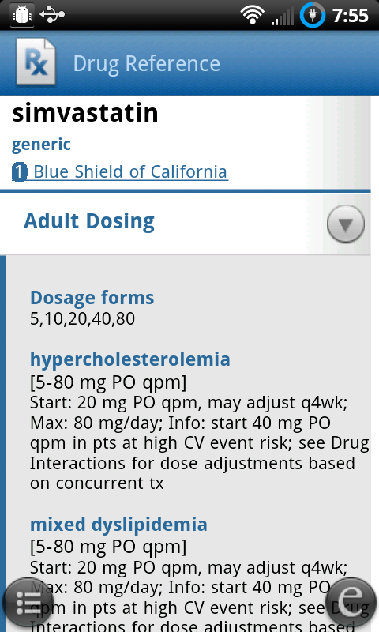
Medical Applications
Drug Reference: Epocrates
Free for drugs only
Full subscription available
Drug interaction checker

Slide 4
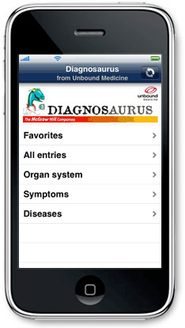
Medical Applications
Differential Dx: Diagnosaurus

Slide 5
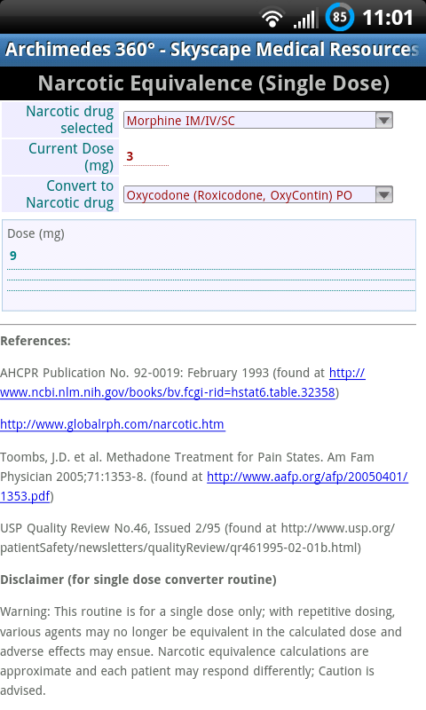
Medical Applications
Calculator: Archimedes
Equations (Na balance)
Risk Scores (Wells)
Opiate Equivalence
Standard: Free
Archimedes 360: $25
Many other free calculators

Slide 6
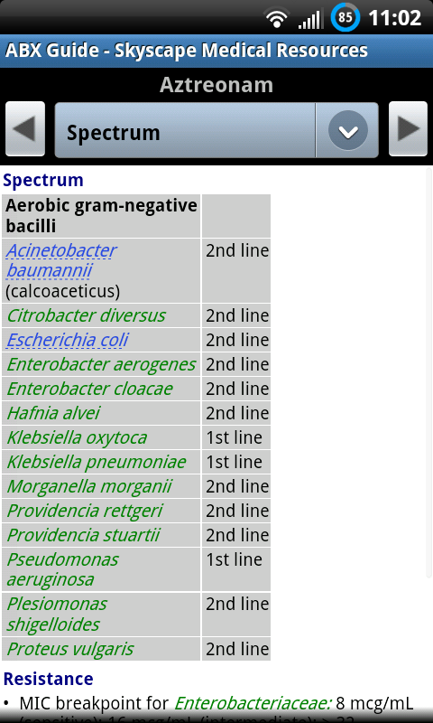
Medical Applications
Antibiotic Guide:
Sanford Guide
Johns Hopkins ABX Guide
$40/$25

Slide 7
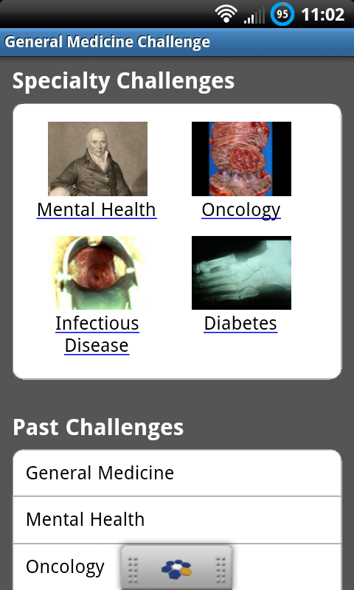
Medical Applications
QuantiaMD

Slide 8
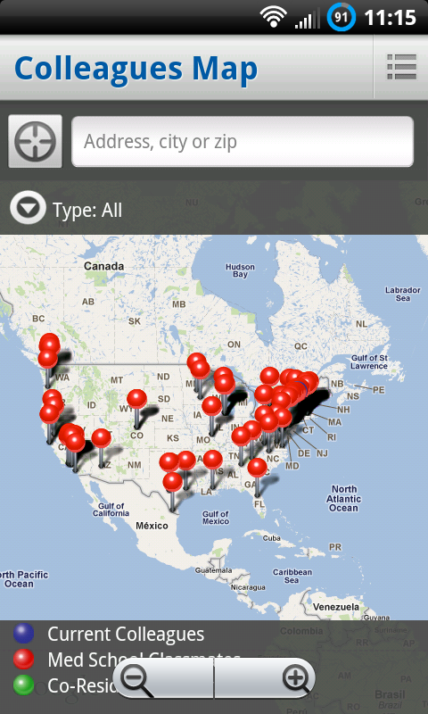
Medical Applications
Doximity
“Facebook for doctors”
Fax number

Slide 9
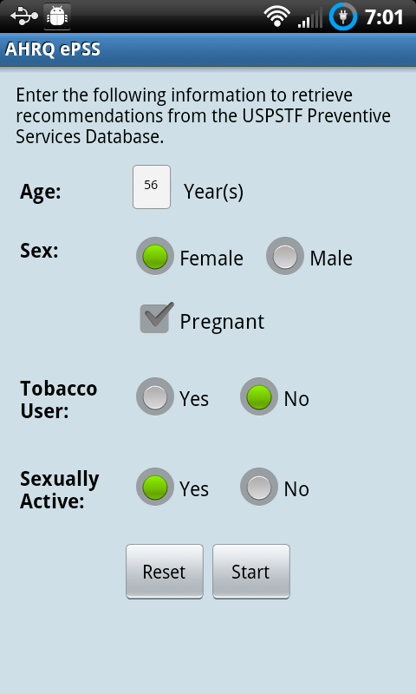
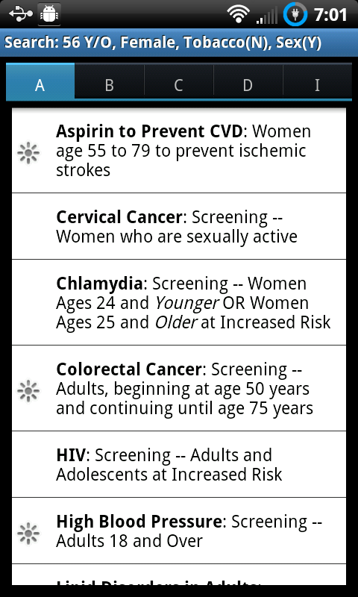
Medical Applications
Primary Prevention: US Dept. Health Services, Agency for Healthcare Research and Quality (AHRQ)

Slide 10
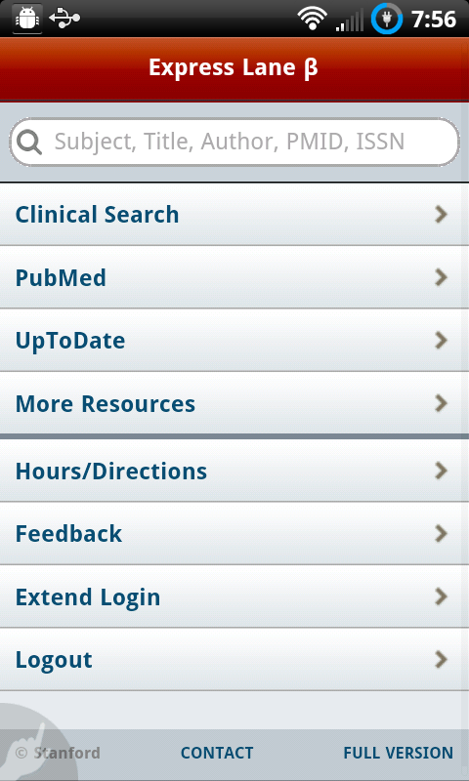
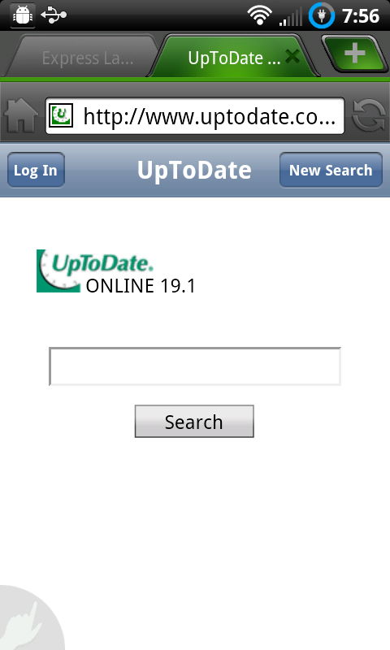
Medical Applications
Lane Library Express:
Website link: http://lane.stanford.edu/m

Slide 11
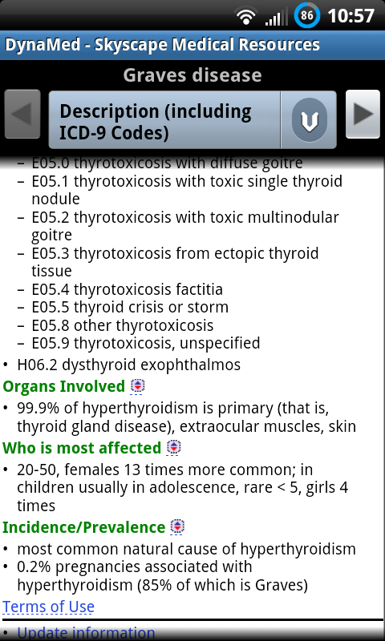
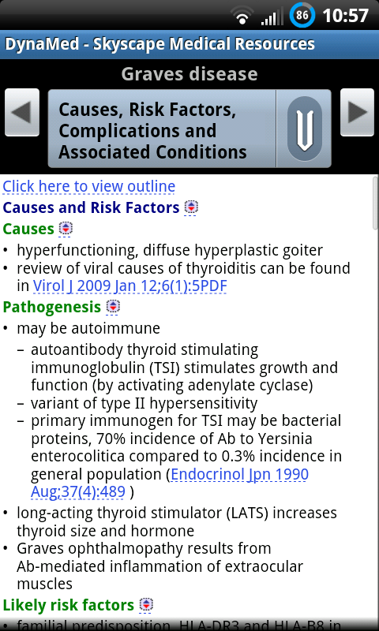
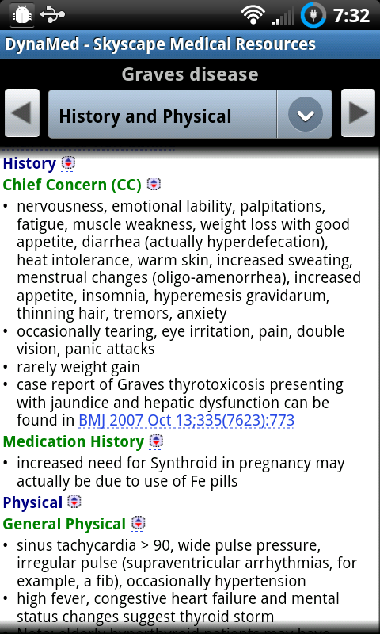
Medical Applications
Medical Reference: Dynamed
Powerful reference program

Slide 12
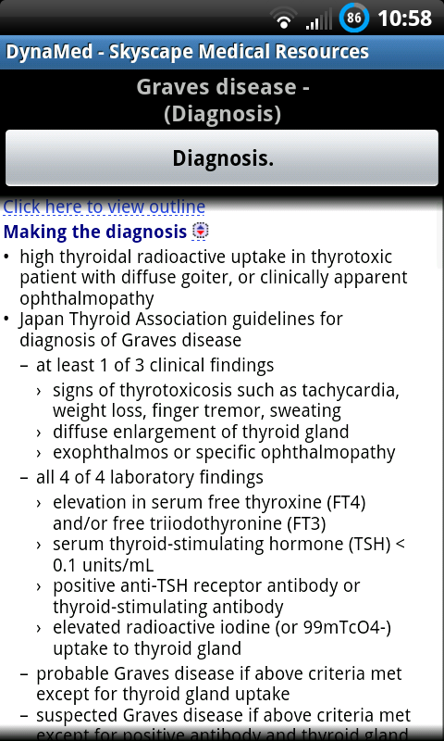
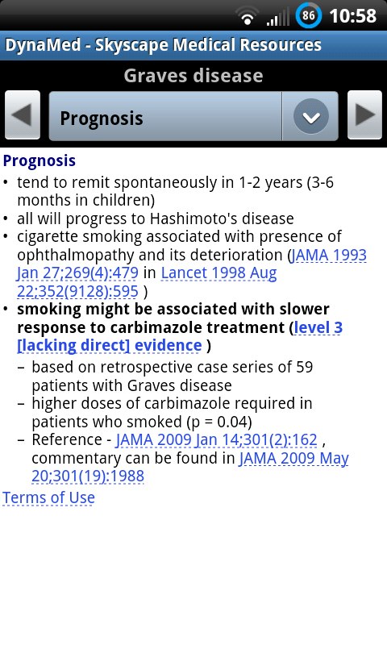
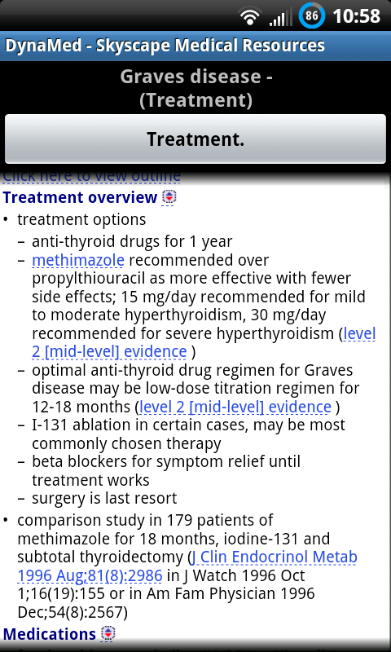
Medical Applications
Medical Reference: Dynamed

Slide 13
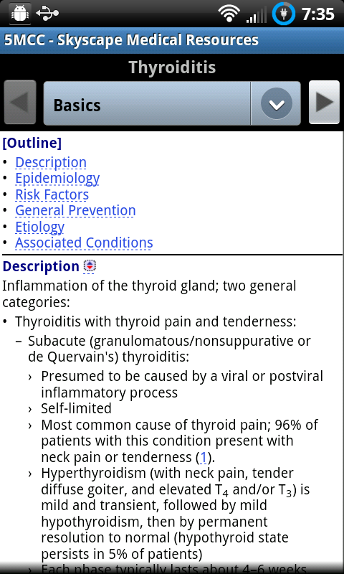
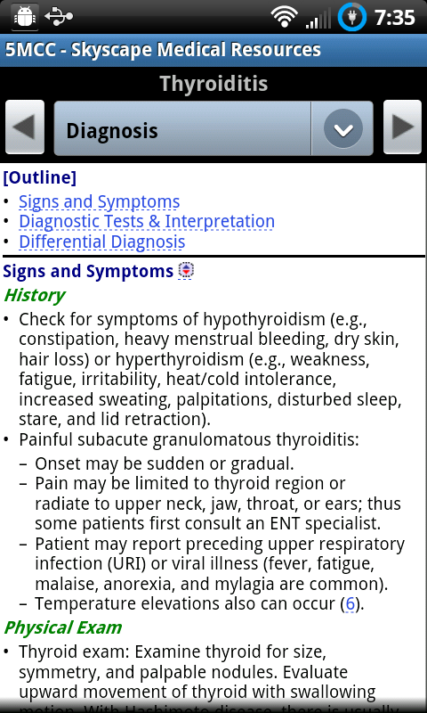
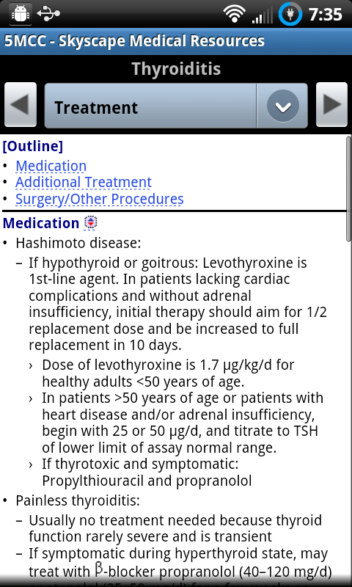
Medical Applications
Medical Reference: 5 Minute Clinical Consult
$80

Slide 14
Other applications
Medscape
Skyscape → many applications, http://www.skyscape.com/index/home.aspx
NEJM (iphone)

Slide 15
Stanford Wifi
Within the hospital:
SHD_Public
Password: 596Ne (case-sensitive)
Stanford Medical School
https://remedyweb.stanford.edu/helpsu/helpsu

Slide 16
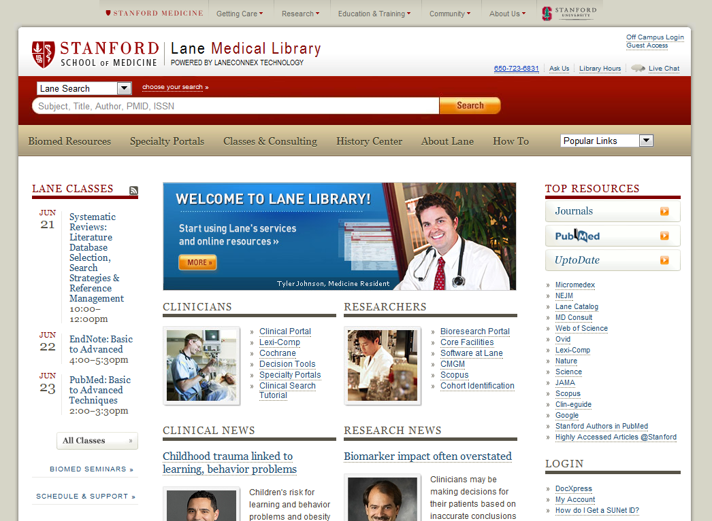
Lane Library: lane.stanford.edu

Slide 17
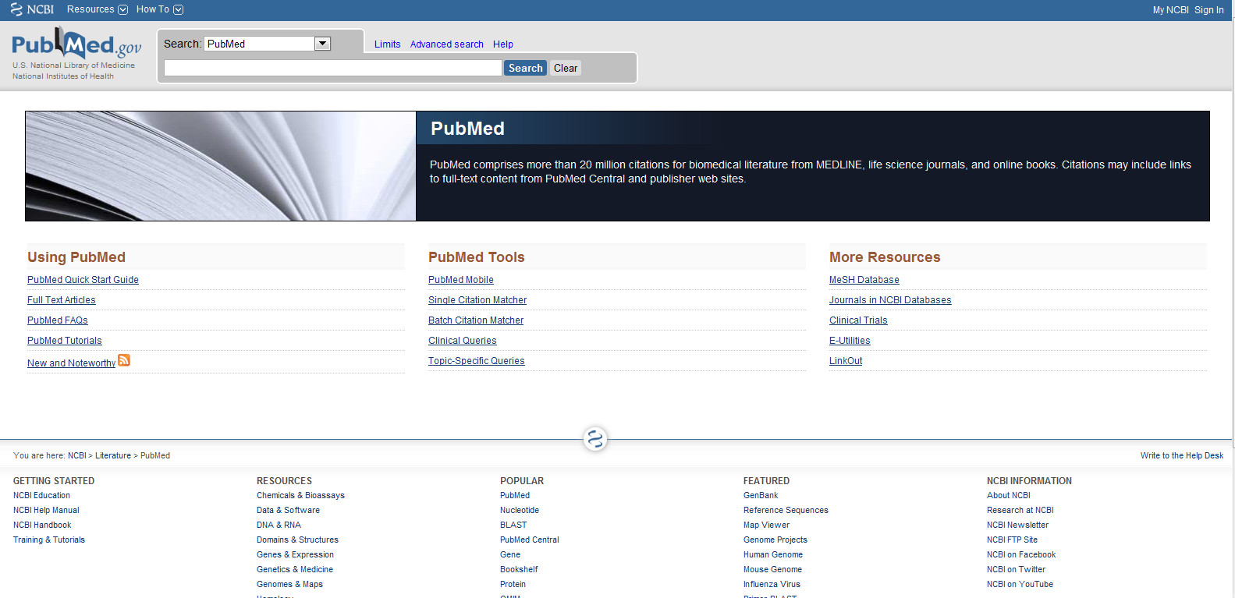
Pubmed & UpToDate

Slide 18
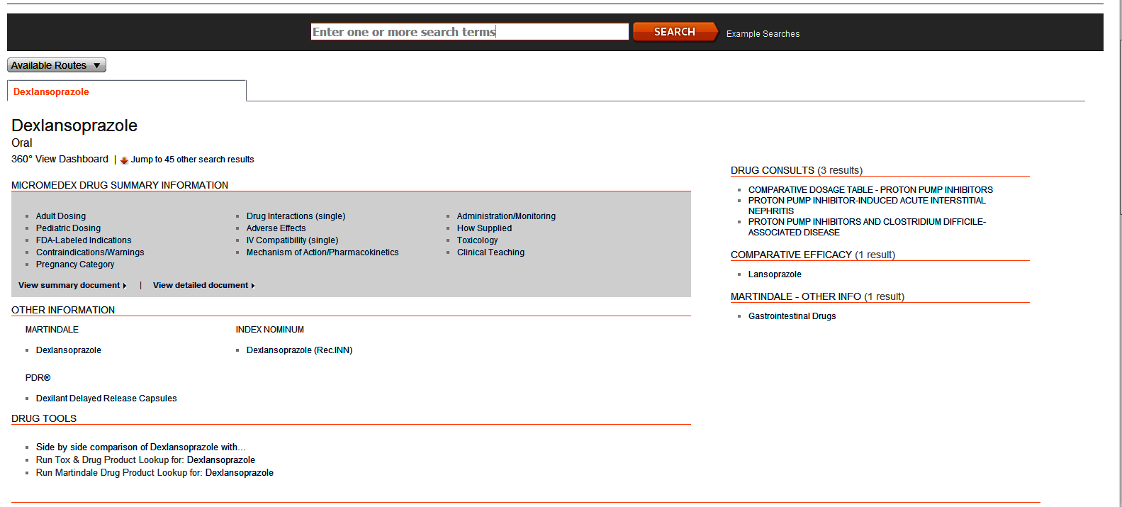
Micromedex http://www.thomsonhc.com.laneproxy.stanford.edu/micromedex2/librarian

Slide 19
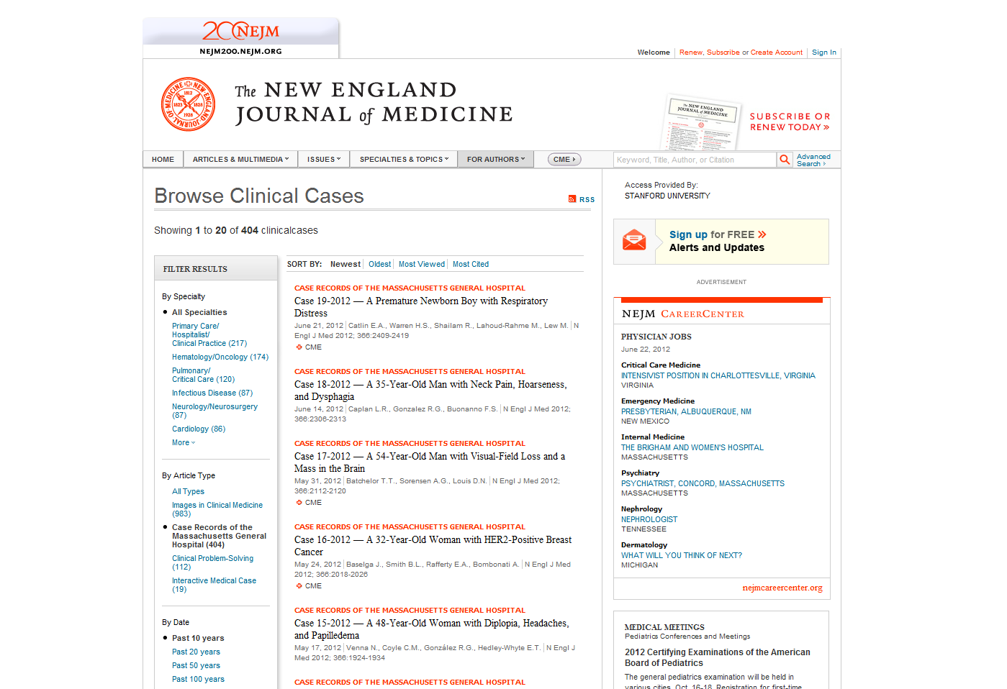
NEJM Clinical Cases

Slide 20
hospitalist.stanford.edu

Slide 21
stanfordmedicine25.stanford.edu

Slide 22
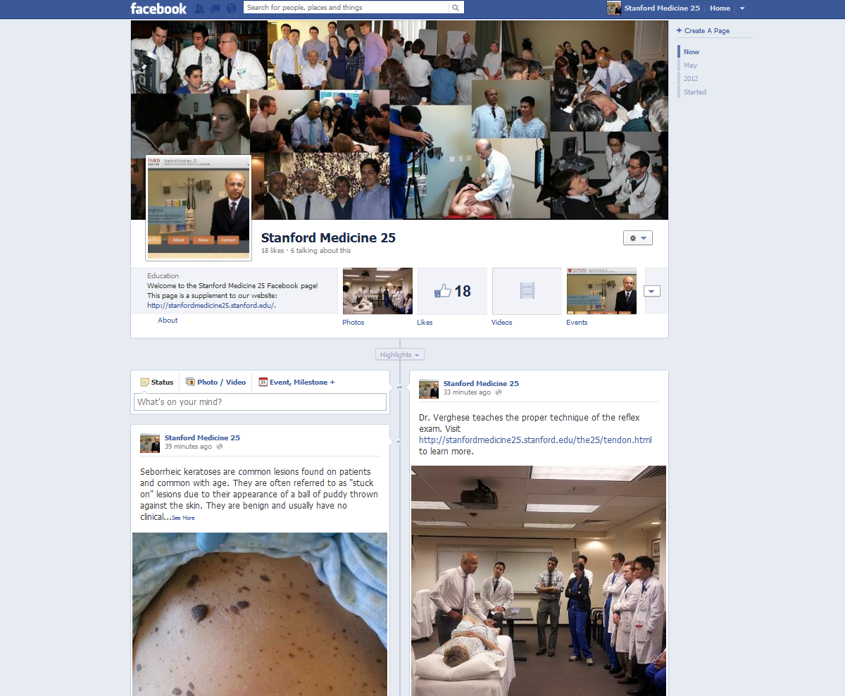

Slide 23
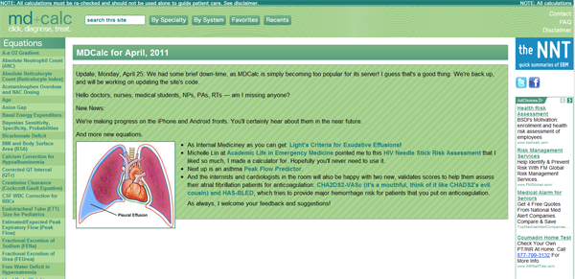
Online Calculators
MD Calc: http://www.mdcalc.com/
Med Calc: http://www.medcalc.com/ (hyper/hyponatremia fluid calculations)
UpToDate: type “calculator” in search (e.g. protein urinary excretion)

Slide 24
Residency Websites
Medhub: stanford.medhub.com
Amion: www.amion.com
Stanford: “stanim”
VA: “pava”
Smartpage: smartpage.stanford.edu
Econnect (benefits, paychecks): www.econnect.stanfordmed.org

